Slide 1
Agile Methodology
https://github.com/emccode/training/blob/master/accreditation/agile-methodology.md#agile-methodology
FIT 2015

Slide 2
Agile 101
You can't gather all the requirements up front. The requirements you do gather will change. There is always more to do than time and money will allow
The Agile Samurai, J. Rasmusson

Slide 3
How bad is it?
18% of software projects are considered "failed", 43% "challenged"
39% actually succeeding
-- 2012 study by The Standish Group
So what’s actually driving this?
Why are companies flocking to agile methods?
Its because the current methods aren't working - they aren't scaling

Slide 4
What can happen without Agile?
Software projects aren't delivered on time to market
Requirements not met with high cost to make changes after delivery
Having to “get it right” first time/up front is really hard
→Unhappy Customers and Developers

Slide 5
Software Development Methodologies
"Code-fix” (or no process)
If you don’t have any real process at all, you have a code-fix process, wherein you 'write code' then 'fix it' repeatedly.
Structured, heavy weight methodologies a.k.a. “Plan Driven Methodologies” and “Waterfall”
Perhaps you are beyond that, and you've gone to a process where you gather requirements, and follow a very specific methodology....If so, its probably a variant of waterfall.

Slide 6
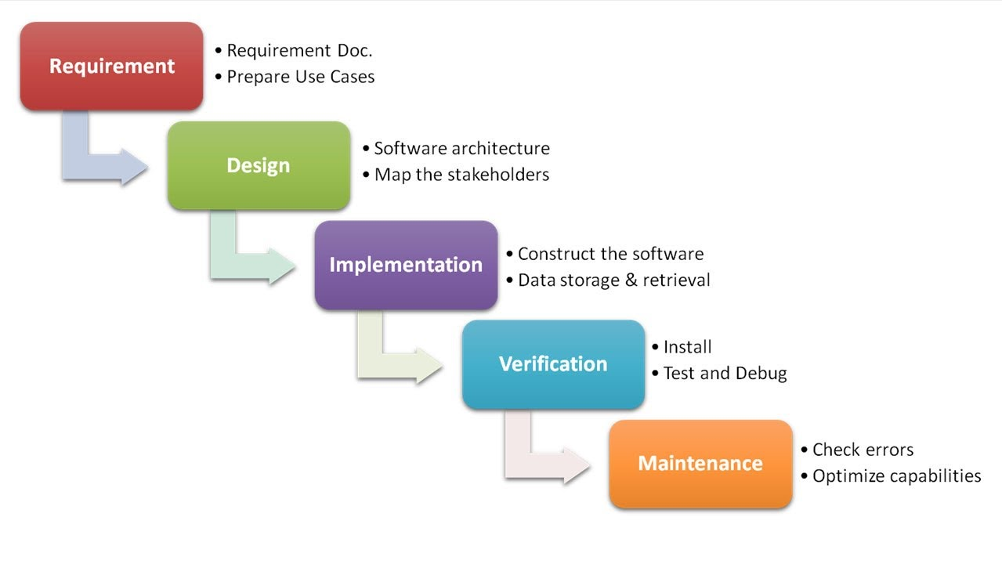
Traditional Waterfall Process

Slide 7
Waterfall Methodology
Largely influenced by traditional engineering and quality processes in industries
Desire to make software development more predictable, measurable and efficient
Strong emphasis on detailed planning and then executing to the plan

Slide 8
But Software is Different
Is not tangible
Is not based on mathematics
Needs knowledge workers
It’s far too fluid and changing compared to math or engineering, and knowledge workers aren't an interchangeable resource!

Slide 9
Relevance
Heavy weight methodologies are most successful when:
Requirements are stable
Technology is well known and mature
Everything happens as one would expect
We are not taking on anything new or unknown
Coding is ‘copy and paste’
But that's just not true for most modern projects

Slide 10
Origins Of Agile
Agile Methods are a reaction to:
Rigidity of heavy weight methods
Bureaucracy introduced by heavy weight methods
Unpleasant surprises due to lack of visibility
The myth that a well defined process is more valuable than the people who use it

Slide 11
Agile Follows Systems Thinking
System Thinking is a way of looking at how things influence each other as a whole and not as individual parts
Focus on Flow, not Function
Look at the end-to-end process and the value we deliver to our customers
What do our customers value
How do we respond to the demands from our customers, as a system

Slide 12
Agile Follows Lean Thinking
Add nothing but value (eliminate waste)
Flow value from demand (delay commitment)
Minimize inventory (minimize intermediate artefacts)
Optimize across the organization
→ this originally comes from the manufacturing world, lest you think it doesn't apply outside software development.

Slide 13
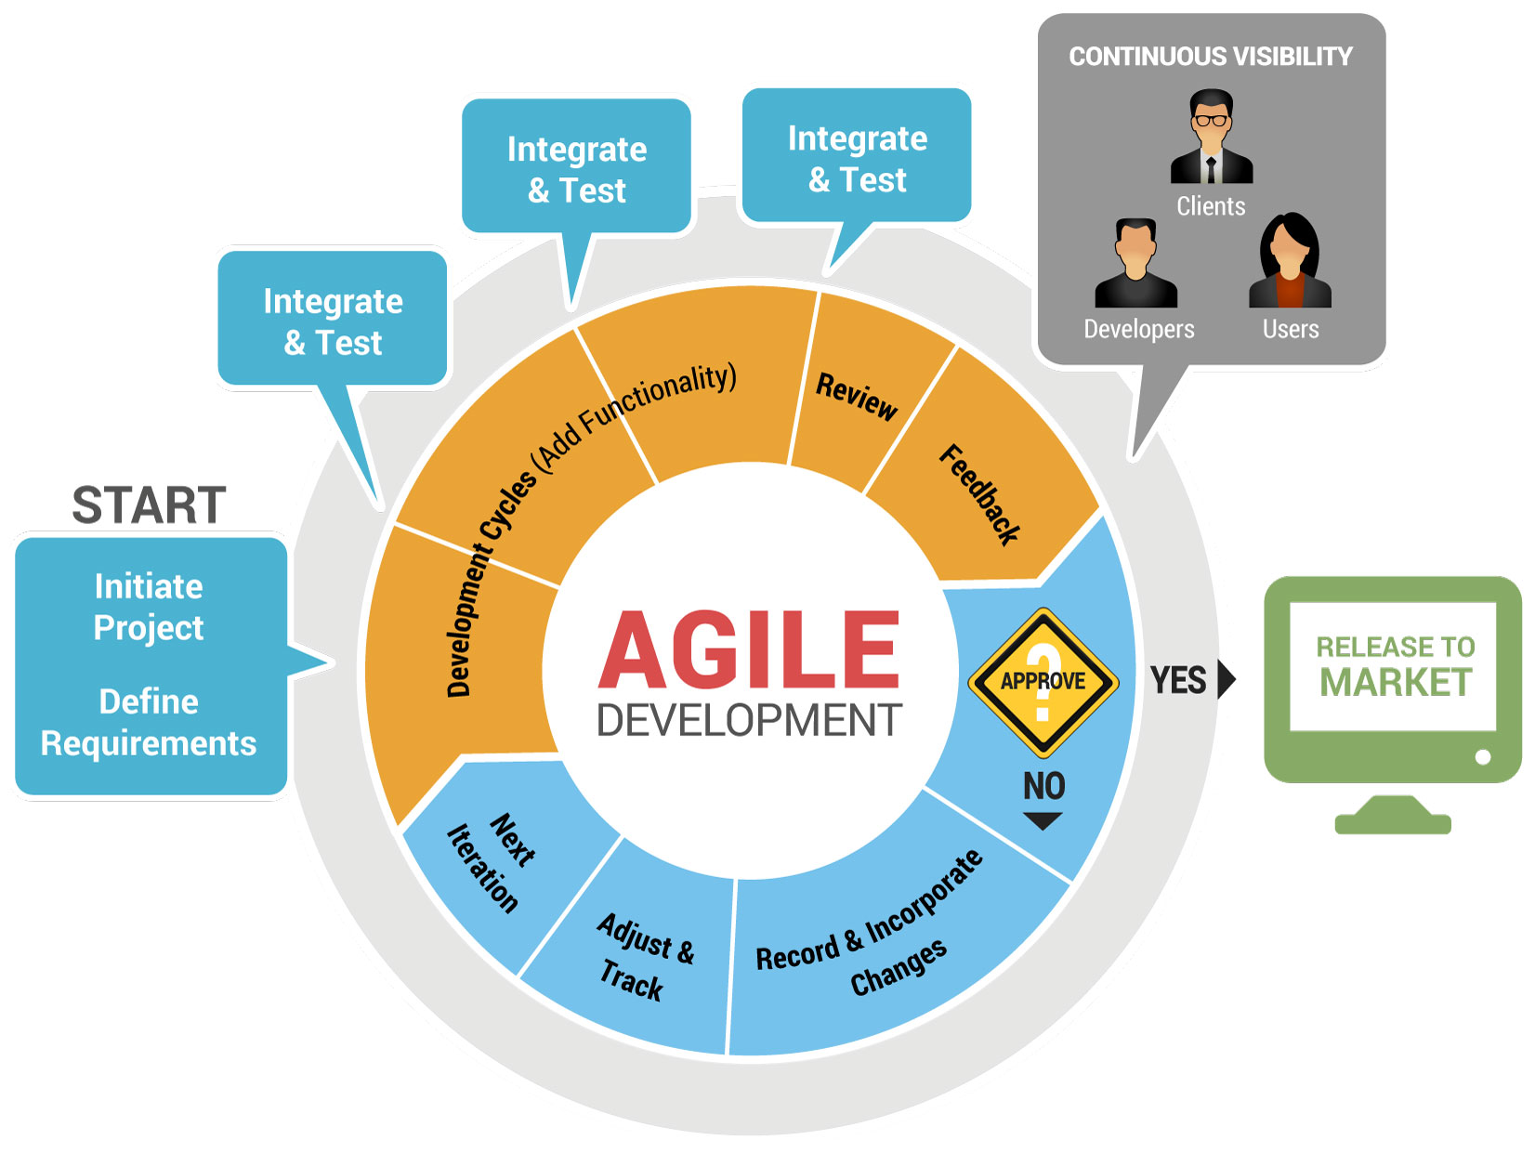

Slide 14
The Agile Manifesto
We are uncovering better ways of developing software by doing it and helping others do it. Through this work we have come to value:
Individuals and interactions over processes and tools
Working software over comprehensive documentation
Customer collaboration over contract negotiation
Responding to change over following a plan.
That is, while there is value in the items on the right, we value the items on the left more.

Slide 15
12 Principles of Agile
Our highest priority is to satisfy the customer through early and continuous delivery of valuable software.
Welcome changing requirements, even late in development.
Deliver working software frequently, with a preference to the shorter timescale.
customer needs are the most important.
late requirements are OK if we can handle them without friction
minimum viable product - working partially the wrong way is better than non working perfection.

Slide 16
12 Principles of Agile (cont)
Business people and developers must work together throughout the project.
Build projects around motivated individuals. Give them the environment and support they need, and trust them to get the job done.
The most efficient and effective method of conveying information is face-to-face conversation.
If biz+devs don't work together, they don't align on goals. In EMC, we call this 'compensation drives behaviour‘
People are at the centre, and will drive happy teams. This comes form the ground up, not top down.
Nothing is better than standing in front of each other. video conferences as a next best.

Slide 17
12 Principles of Agile (cont)
Working software is the primary measure of progress.
Agile processes promote sustainable development. The sponsors, developers, and users should be able to maintain a constant pace indefinitely.
Continuous attention to technical excellence and good design enhances agility.
Working > Everything else
Prevent heroism. Heroes are bad because they burn out.
Avoid technical debt.

Slide 18
12 Principles of Agile (cont)
Simplicity - the art of maximizing the amount of work not done - is essential.
The best architectures, requirements, and designs emerge from self-organizing teams.
At regular intervals, the team reflects on how to become more effective, then tunes and adjusts its behaviour accordingly.
Simplicity also drives the ability to change quickly.
Teams building, not high-level arch teams, determine the best methods.
Agile itself is iterative.

Slide 19
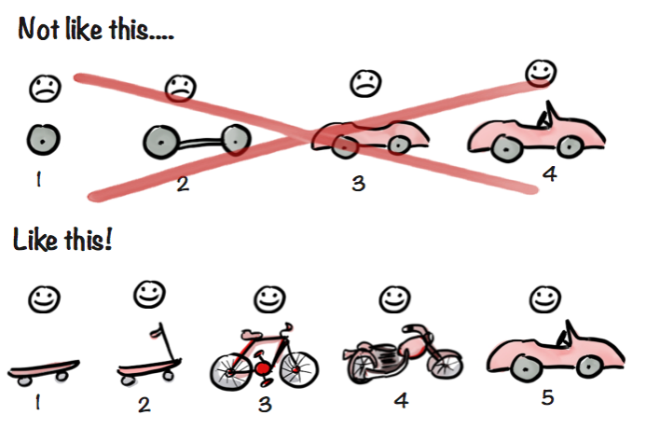
Minimum Viable Product (MVP)
In this example, we build 5 new products...does that possibly take more overall work? Maybe, but we make revenue the WHOLE TIME, not just after step 4, when its expensive to fail.

Slide 20
Agile Myths
No Planning
There's a ton of planning, its just done for shorter time frames
No Documentation
There's documentation in all of the discussions done by the team in the Kanban boards and the code. The lack of a 'master plan' is a positive.
Lacks Discipline
It requires more discipline to follow this and trust your team.
Limited to Co-Located Teams
Co-located teams are easier (especially newbies), but remote teams can be done with modern tools
Open Ended
Agile is indeed open ended, in that we are always looking to iterate. Its not open ended with working software, which is delivered at the end of every sprint. We only commit to what we can finish.

